Slide 1
IBM University Engagement Project Submission
“Exploring the Power of Agentic AI with IBM Granite and IBM Bob”

Slide 2
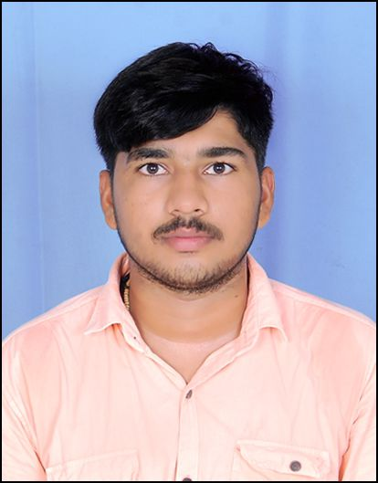
Project Tile – AI-Powered Cotton & Groundnut Market Linkage Platform
Domain of Project – Economic Development
Student Name | Recent Passport Photo | Email ID | Mobile number [WhatsApp]
Vishal D. Rojasara |  | vishalrojasara5261@gmail.com | 7778915261

Slide 3
Problem Statement -
Problem Statement : Smart Rann of Kutch Eco-Tourism & Carrying Capacity Planner
Domain: Tourism
The Challenge
The Rann Utsav and Kutch region attract heavy seasonal tourist inflow, straining fragile desert ecology, local water resources, and infrastructure, while visitors lack guidance on sustainable and lesser-known eco-tourism alternatives.
Objective
Build Agentic AI solutions that manage tourist load, recommend sustainable travel itineraries, andprotect ecolog ically sensitive zones in Kutch and surrounding regions.
Suggested AI Agents
• Tourist Load Forecasting Agent
• Sustainable Itinerary Recommendation Agent
• Ecological Carrying Capacity Agent
• Local Artisan & Community Linkage Agent
• Tourism Impact Dashboard Agent
Technology to be used – IBM Bob + IBM Granite LLM + IBM cloud

Slide 4
Proposed Solution -
Proposed Solution: AI-Powered Smart Rann of Kutch Eco-Tourism & Carrying Capacity Platform
Agentic AI platform that intelligently manages tourist inflow in the Rann of Kutch while protecting fragile desert ecosystems and supporting local communities.
5 specialized AI agents — Tourist Load Forecasting, Sustainable Itinerary Planning, Ecological Carrying Capacity, Community & Artisan Matching, and Tourism Impact Dashboard — coordinated by a central AI Orchestrator.
Tourists and authorities can interact in plain Gujarati/Hindi/English through a simple AI chat interface and receive direct answers such as:
“Is the Rann crowded today?”
“Suggest a less crowded alternative.”
“Plan a 3-day sustainable Kutch trip.”
“Can I visit this destination safely?”
“Which local artisan experiences should I visit?”
“What is the tourism pressure in Kutch?”
IBM Granite LLM acts as the conversational intelligence layer, while IBM Cloud/watsonx can be used for AI deployment and orchestration.
The platform combines tourist-load data, destination information, carrying-capacity metrics, community/artisan data, weather or external data where connected, and ML predictions to generate responsible recommendations.
The system clearly distinguishes verified information, demo data, ML predictions, and AI-generated recommendations, reducing the risk of presenting estimates as facts.
Predictive intelligence forecasts tourist pressure and identifies destinations that may become overcrowded, allowing the system to redirect visitors toward safer and lesser-known alternatives.
Sustainability-aware recommendations balance tourist demand with ecological carrying capacity, helping prevent excessive pressure on fragile desert regions.
Community linkage connects tourists with local artisans, handicrafts, cultural experiences, and community-based tourism opportunities, helping distribute tourism revenue to local communities.
A simple ChatGPT-style multilingual interface makes the platform accessible to tourists using basic smartphones without requiring technical knowledge.

Slide 5
Technology Used
IBM Bob platform -For designing and orchestrating multi-agent workflows visually
IBM Grainte model - for eg – ibm-granite-3-2-8b – For natural language understanding, reasoning, and personalization
IBM Cloud – It provides the infrastructure to build, deploy, and scale the Nutrition Agent efficiently. IBM Cloud enables a reliable, secure, and scalable environment for deploying the Nutrition Agent.
RAG– RAG to fetch real data first, then generate intelligent answers, making the Nutrition Agent more trustworthy and effective.
IBM Watsonx.ai - For model deployment, embeddings, and AI governance
Vector Database (FAISS/Chroma) – For RAG-based nutritional data retrieval

Slide 6
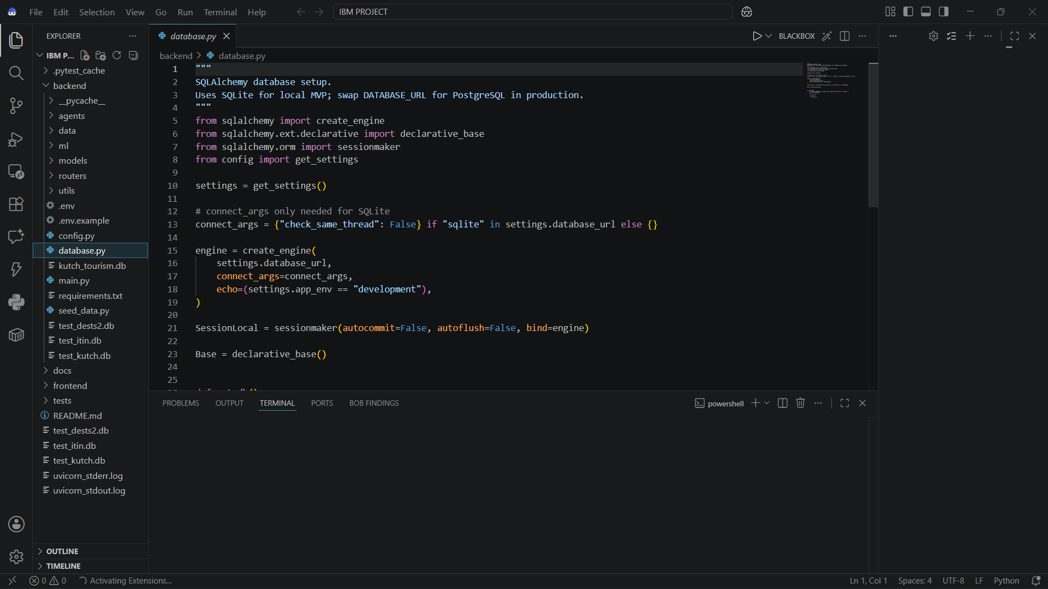
Required Files created using IBM bob -
App.py
Requirements.txt
Style.css
.env
Index.html

Slide 7
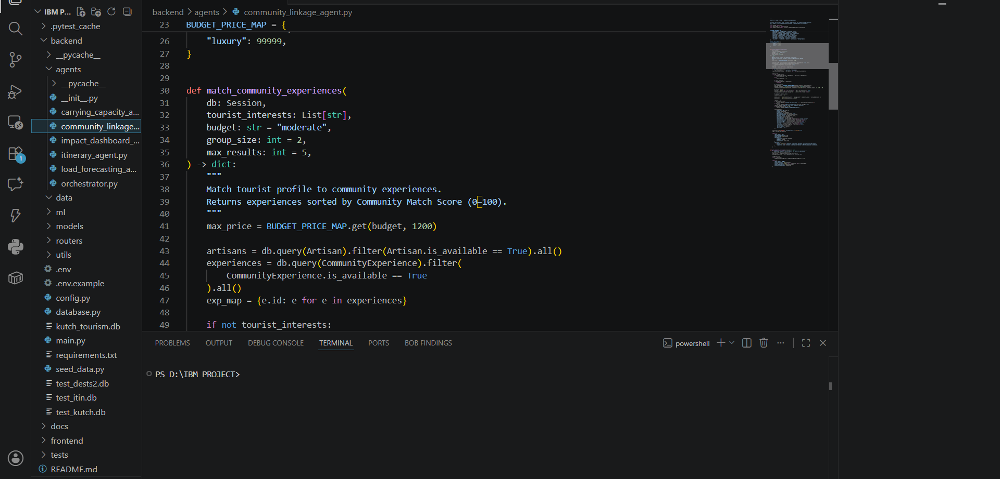
IBM Bob Screenshots:

Slide 8

Role of Agentic AI in the solution
Role of Agentic AI-Powered Smart Rann of Kutch Eco-Tourism Platform
Multi-agent, not a single chatbot — each specialized AI agent owns a specific tourism decision, such as tourist-load prediction, itinerary planning, ecological capacity, or community linkage.
Orchestrator agent automatically identifies tourist or authority intent and routes the request to the appropriate specialist agent, eliminating manual navigation between different modules.
Tourist Load Forecasting agent analyzes historical and current visitor patterns to predict crowd levels and identify destinations at risk of over-tourism.
Sustainable Itinerary agent reasons across tourist preferences, crowd levels, ecological sensitivity, available attractions, distance, and tourism capacity to generate a practical and sustainable travel plan.
Carrying Capacity agent evaluates tourism pressure against environmental and infrastructure limits and recommends whether a destination should be promoted, limited, or avoided.
Community Linkage agent proactively recommends local artisans, handicraft experiences, homestays, cultural activities, and community-based tourism opportunities, helping distribute tourism benefits locally.
Impact Dashboard agent combines tourism, environmental, and community indicators to provide authorities with actionable insights rather than only displaying statistics.
Agents can use external tools and data sources such as tourist statistics, destination databases, weather information, maps, and other connected APIs, enabling situation-aware recommendations instead of static Q&A.
The system distinguishes live/verified data from predictions and AI-generated recommendations, improving transparency and reducing misleading decisions.
Net effect: shifts tourism management from “answering tourist questions” to “recommending the next sustainable action” — where to go, when to go, where to avoid, how to distribute tourist load, and how to protect Kutch's fragile ecosystem.

Slide 9
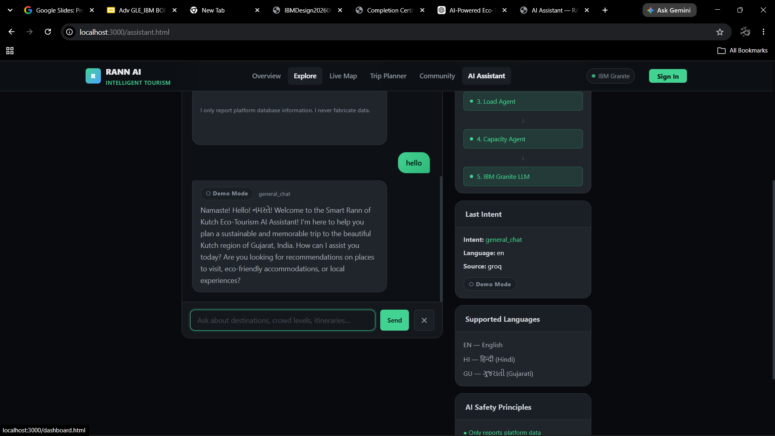
Project Output Screenshot
Please put IBM Bob output screenshots with 2-3 prompts.
You can take 2-3 more slides for each screenshot
·
·
·

Slide 10
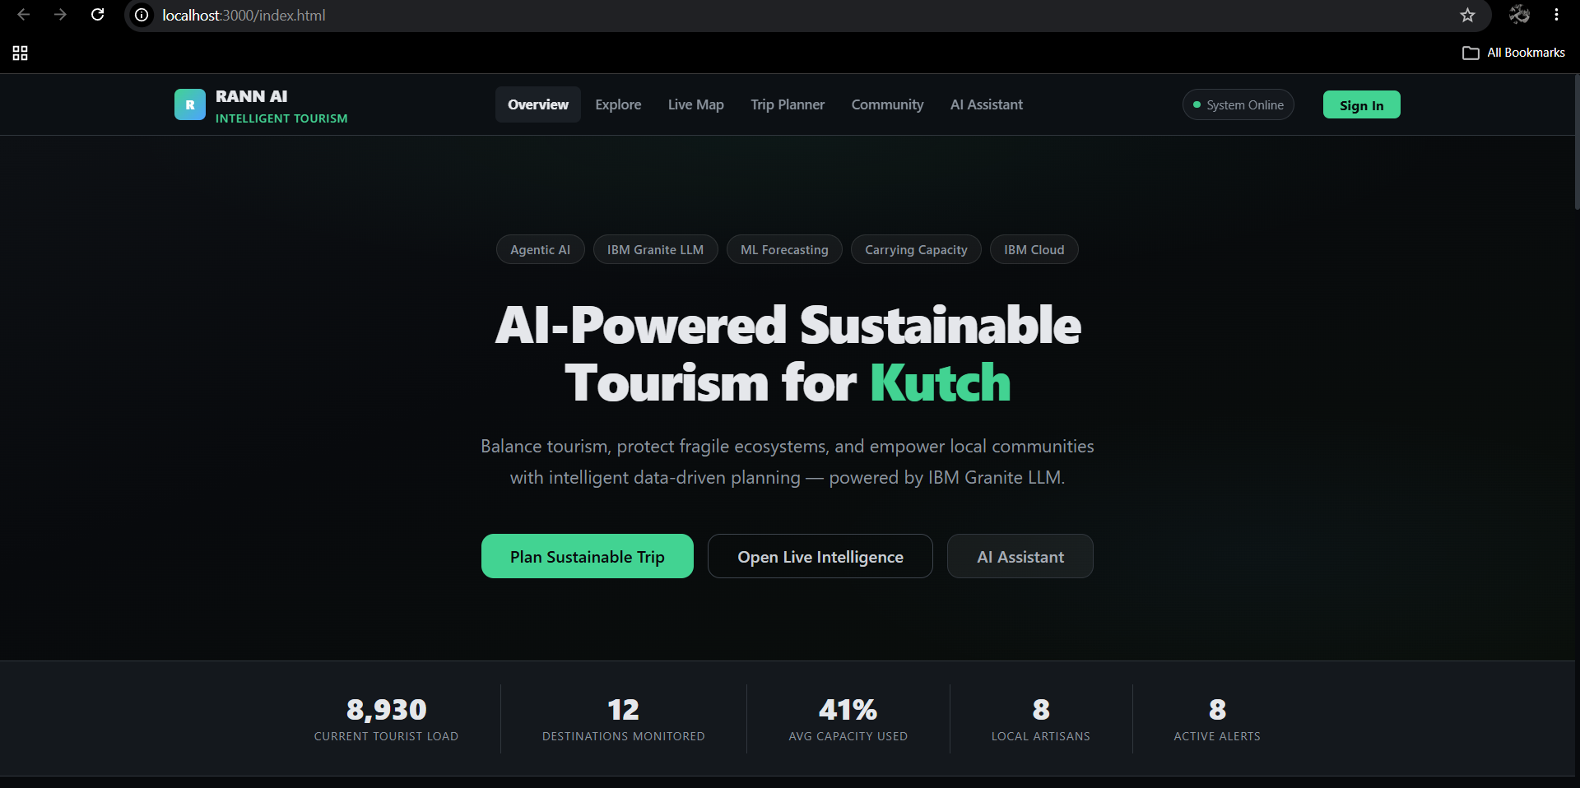
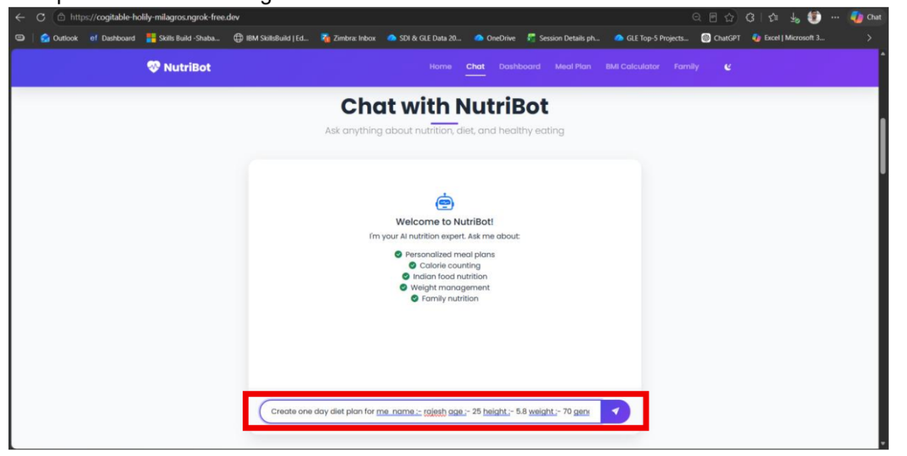
Project Output Screenshot
Please put IBM Bob output screenshots with 2-3 prompts.
You can take 2-3 more slides for each screenshot
·
·
·

Slide 11
Novelty and Uniqueness
The proposed Smart Rann of Kutch Eco-Tourism Platform stands out by combining Agentic AI, predictive analytics, sustainability intelligence, and personalized tourism recommendations into a single intelligent system.
Multi-Agent Intelligence – Instead of relying on a single chatbot, multiple specialized AI agents collaborate to handle tourist-load forecasting, itinerary planning, ecological carrying capacity, community linkage, and tourism impact analysis.
Agentic Decision-Making – The system goes beyond answering tourist questions by autonomously analyzing the situation and recommending the next best sustainable action, such as visiting an alternative destination or avoiding an overcrowded zone.
Predictive Tourist Load Management – Uses historical and available real-time tourism data to forecast visitor pressure and identify destinations that may experience overcrowding.
Carrying-Capacity Awareness – Recommendations consider the ecological and infrastructural limits of sensitive areas, helping balance tourism growth with environmental protection.
Personalized Sustainable Itineraries – Generates travel plans based on tourist interests, available time, budget, crowd levels, destination sensitivity, and sustainability considerations.
Community-Centric Tourism – Connects tourists with local artisans, handicrafts, homestays, cultural experiences, and community-based activities, helping distribute tourism revenue beyond major tourist hotspots.
Real-Time & Context-Aware Recommendations – Where connected, the platform can use external data such as weather, tourist statistics, destination information, and maps to make recommendations more relevant to current conditions.
Multilingual & Accessible AI – Supports Gujarati, Hindi, and English, allowing local tourists, visitors, and authorities to interact naturally through a simple smartphone-friendly interface.
Transparent AI Recommendations – Clearly distinguishes between verified/live information, historical data, predictions, and AI-generated recommendations, improving trust and responsible decision-making.
IBM Enterprise AI Integration – Built around IBM Granite models and IBM watsonx/IBM Cloud, providing a foundation for scalable, governed, and enterprise-ready Agentic AI deployment.

Slide 12
Git Hub Link
· Please create public github repository (Enable Add README button while creating repository) with format –
Please test and Paste the working Github URL https://github.com/RojasaraVishal/Smart-Rann-of-Kutch-Eco-Tourism-Carrying-Capacity-Planner.git
Make sure you have Uploaded following three files into your github repository 1) All Agent relevant files of IBM Cloud , 2) yourproblemstatement.pdf file 3) your projectpresntation.pptx file 4)any other files
·
·
·

Slide 13
Future Scope
1.Integration with Wearables & Health Devices –
The system can be integrated with smartwatches and fitness trackers to collect real-time data such as steps, calories burned, heart rate, and sleep patterns. This will enable the Nutrition Agent to provide more accurate and dynamic diet recommendations based on actual user activity and health metrics.
2.AI-Powered Voice Assistant & Multilingual Support –
Enhancing the system with a voice-enabled assistant and support for multiple languages will improve accessibility. Users can interact naturally in their preferred language, making the solution more inclusive and suitable for diverse populations, especially in regions with varied linguistic backgrounds.
·
·
·

Slide 14
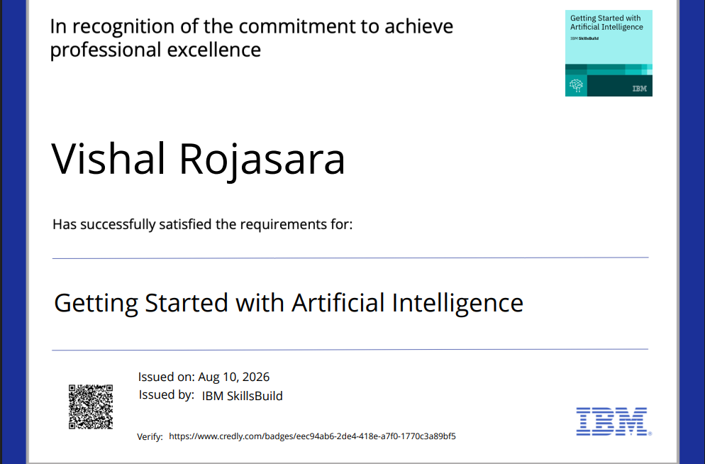
Certificates Earned:
Please add your credly certificate

Slide 15
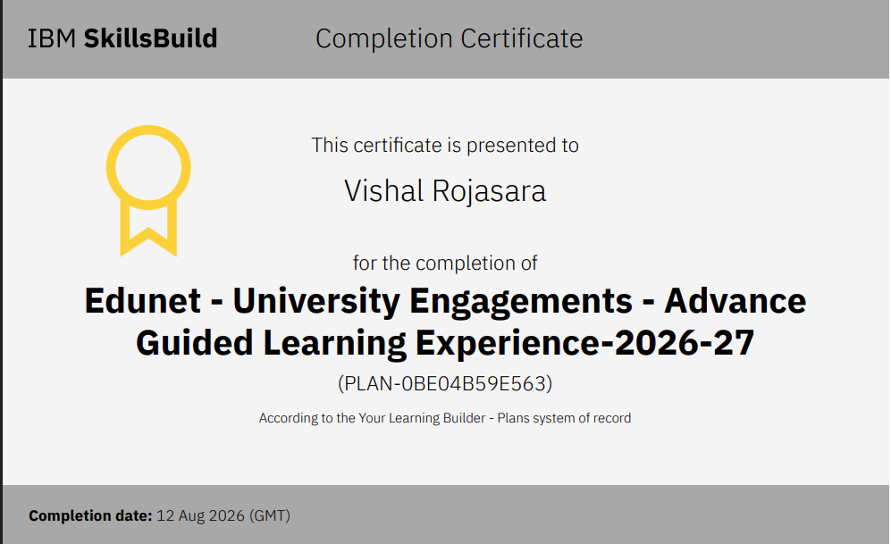
Certificates Earned:​
Add your IBM BOB Certificate

Slide 16


